Slide 1
BOOSTING ALGORITHM
ADABOOST ALGORITHM
XGBOOST ALGORITHM
LGBOOST ALGORITHM

Slide 2
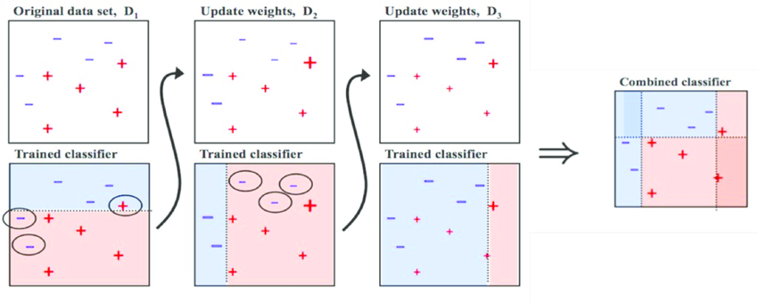
BOOSTING ALGORITHM

Slide 3
Boosting is a machine learning ensemble technique that combines the predictions of multiple weak learners to create a strong and accurate predictive model.
The basic idea behind boosting is to sequentially train a series of weak models, each focusing on the mistakes of its predecessor, and combine their predictions to form a more robust overall model.
The term "boosting" reflects the concept of boosting the performance of a weak learner to achieve better predictive accuracy.

Slide 4
ADABOOST ALGORITHM
AdaBoostRegressor combines the predictions of multiple weak learners (usually decision trees) to create a robust and accurate predictive model.
AdaBoost was one of the first boosting algorithms. It focuses on the examples that were misclassified by the previous weak learners.
In each iteration, AdaBoost assigns different weights to the data points, emphasizing the importance of misclassified points.
It combines weak learners (usually decision trees) with different weights to form a strong ensemble model as shown in the below diagram

Slide 5
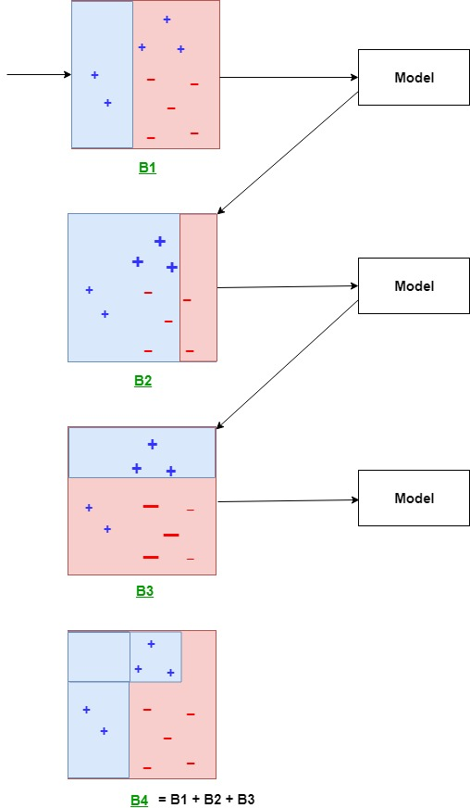
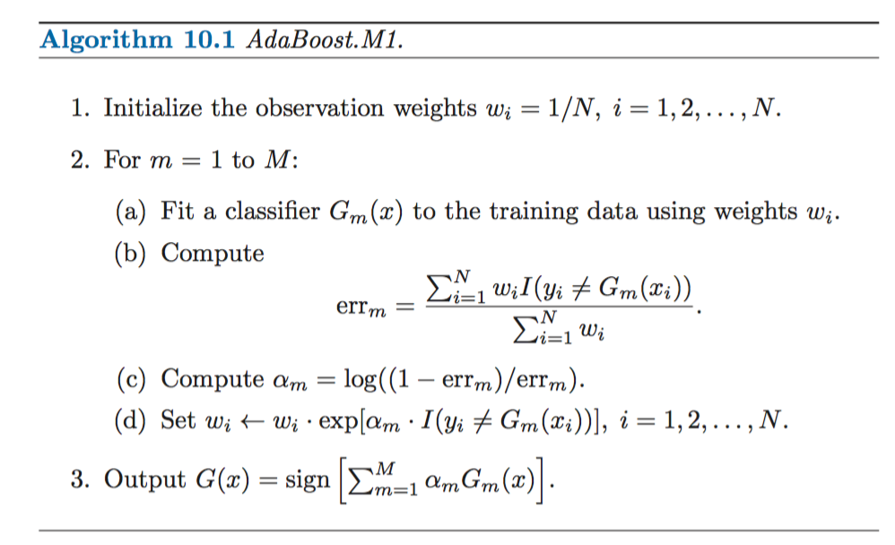

Slide 6
XG BOOST ALGORITHM
Gradient Boosting is a general framework that includes algorithms like Gradient Boosted Trees.
It builds trees sequentially, with each tree correcting the errors of the previous ones.
Unlike AdaBoost, Gradient Boosting minimizes a loss function in the prediction space by adding weak learners (typically decision trees) in a forward stage-wise manner.
Popular implementations include scikit-learn's GradientBoostingRegressor and GradientBoostingClassifier.

Slide 7
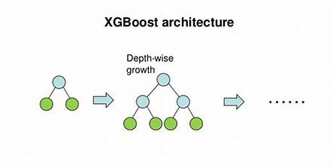
Depth-wise growth happens by decreasing loss function in each stage and finally we get the lowest loss function at the end, will lead to get the perfect prediction.

Slide 8
LGBOOST ALGORITHM
LightGBM is another gradient boosting framework that is designed for distributed and efficient training.
It uses a histogram-based learning method, which makes it computationally efficient and scalable.
It's known for its efficiency, speed, and the ability to handle large datasets.
Leaf-wise tree growth, randomly selects the node for growth and predicts, result will be obtained on the majority basis.

Slide 9
